Slide 1
Car-Studio Slide
Aptech Computer Education

Slide 2
Hello!
Systems are created to solve things that humans cannot do or do things that humans do over and over again. And so is our DCakeShop system.
Welcome

Slide 3



Member Of Group3
Conference speakers
Nguyễn Trọng Thăng
Trịnh Hữu Dương
Lê Văn Toản
Leader
Member
Member

Slide 4
01
Find out the problem
Conference speakers

Slide 5


Reason
IT industry is growing
The food processing industry is never out of date
=> Web sell Cake System is useful
Tìm hiểu vấn đề

Slide 6

1.2. The Current System

Slide 7
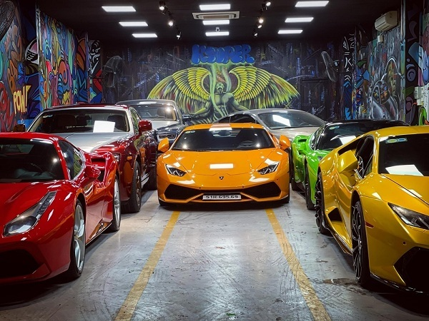
Description
Customers have to come to the place to buy cakes. Or call the store.
Customers will hear the staff's introduction through each type of cake.
When choosing the cake, the customer will buy and pay
Tìm hiểu vấn đề

Slide 8
Timeline
Defect

Slide 9

Space
Need to rent a large space (expensive) if you want to serve enough guests.
If there are few customers, it is easy to lose capital => go bankrupt.
Having difficulty in displaying the cakes and cakes for sale
Tìm hiểu vấn đề

Slide 10

Shopping Online
Shopping online is trending
Tìm hiểu vấn đề

Slide 11

Quality Service
If there are too many guests, the quality of service will be affected
If you want to improve, you need to hire staff. (Loss of extra salary).
If you hire employees, it will be quite difficult to adapt when supply and demand change
Tìm hiểu vấn đề

Slide 12
=>A website selling cakes is extremely necessary to adapt to the digital age 4.0
Tìm hiểu vấn đề

Slide 13

02
System
Our time

Slide 14
Function Of System
a) System for Admin
b) System for Client
Hệ thống

Slide 15
a) System for Admin
Admin can create, update, read, delete event and cake
Admin can read, update Admin and Customer
Admin can login and logout
Hệ thống

Slide 16
b) Function for Client
Customer can read event and Cake, Search the Cake
Customer can order Cake
Customer can sign-up and feed back for admin
Hệ thống

Slide 17

3) System Design

Slide 18
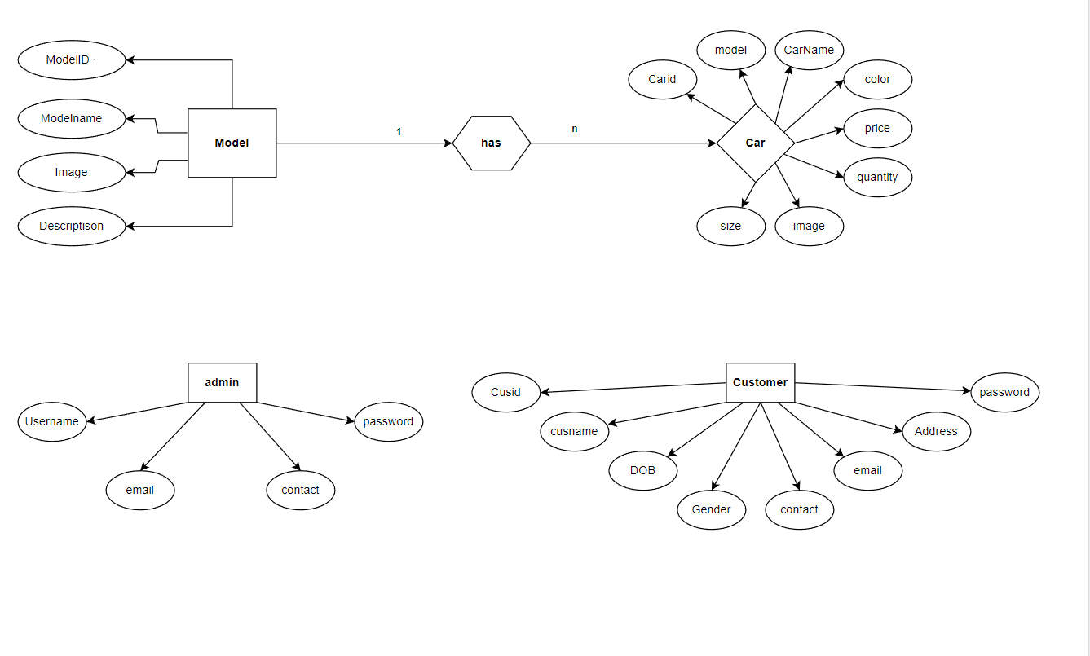
ER Diagram
Thiết kế hệ thống

Slide 19
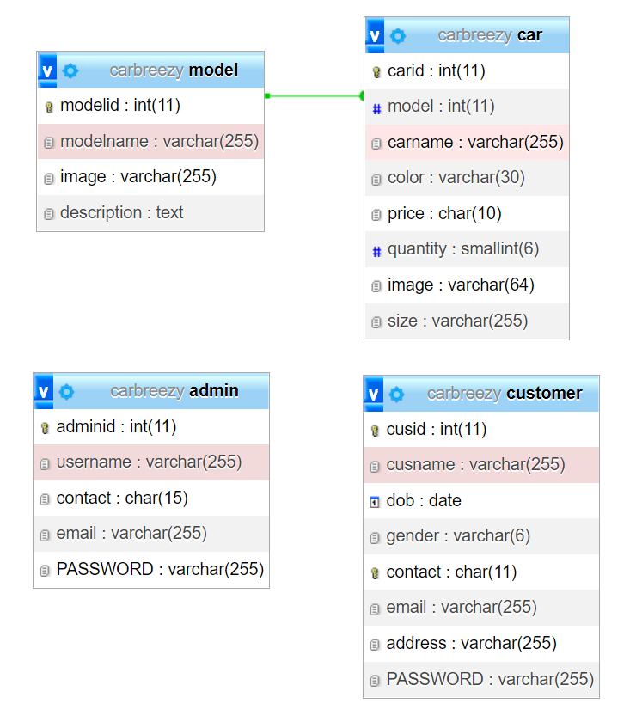
Database Design
Thiết kế hệ thống

Slide 20
Site Map Design
Home Page
Topic1
Topic2

Slide 21
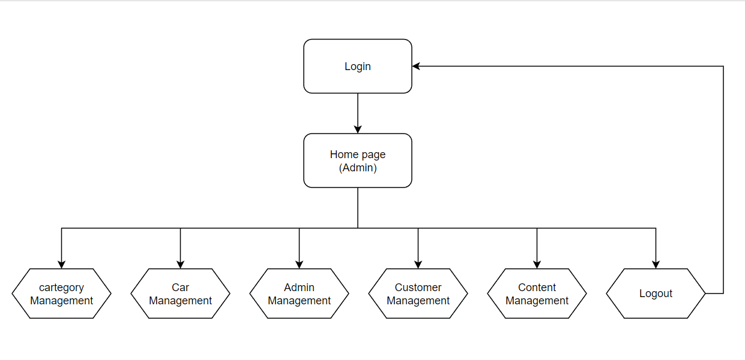
Site Map Admin
Thiết kế hệ thống

Slide 22
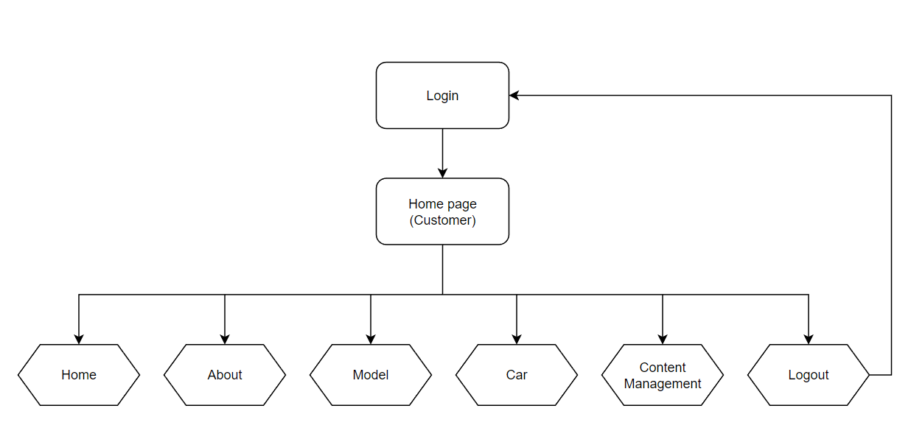
Site Map Customer
Thiết kế hệ thống

Slide 23
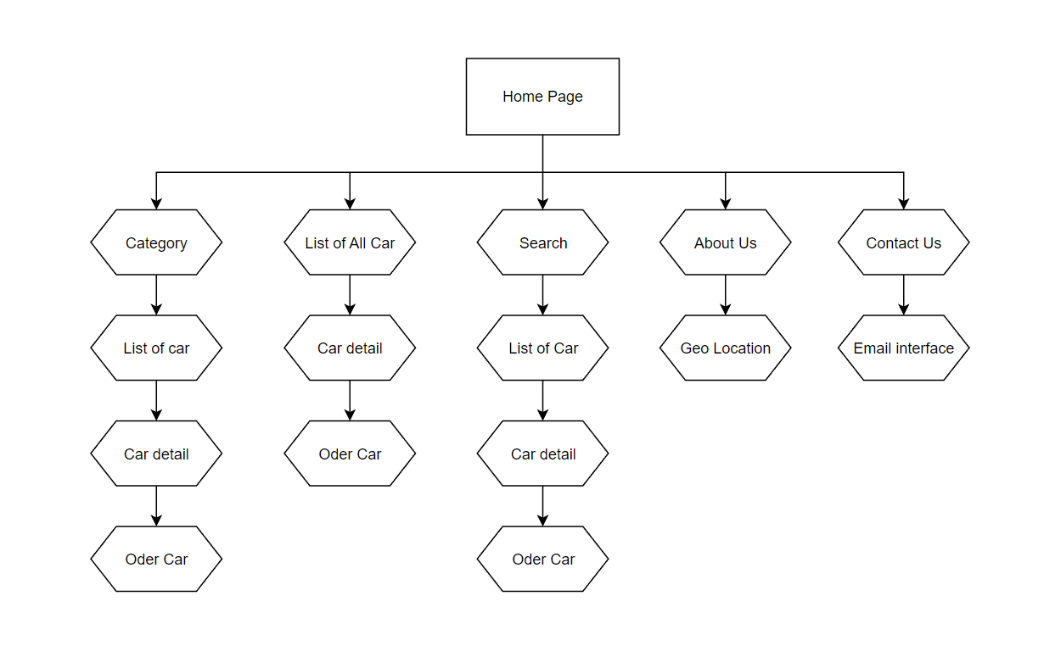
Site Map Client
Thiết kế hệ thống

Slide 24
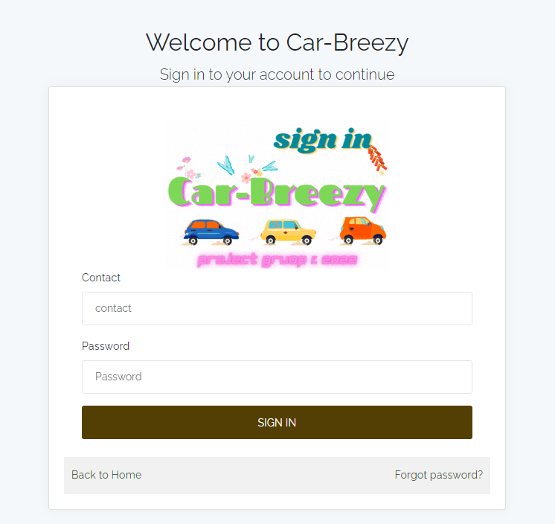
System Deployment
Pricing

Slide 25
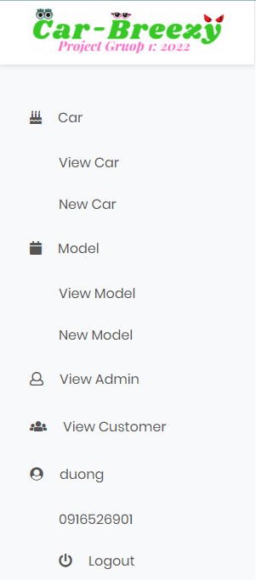
Side bar page

Slide 26
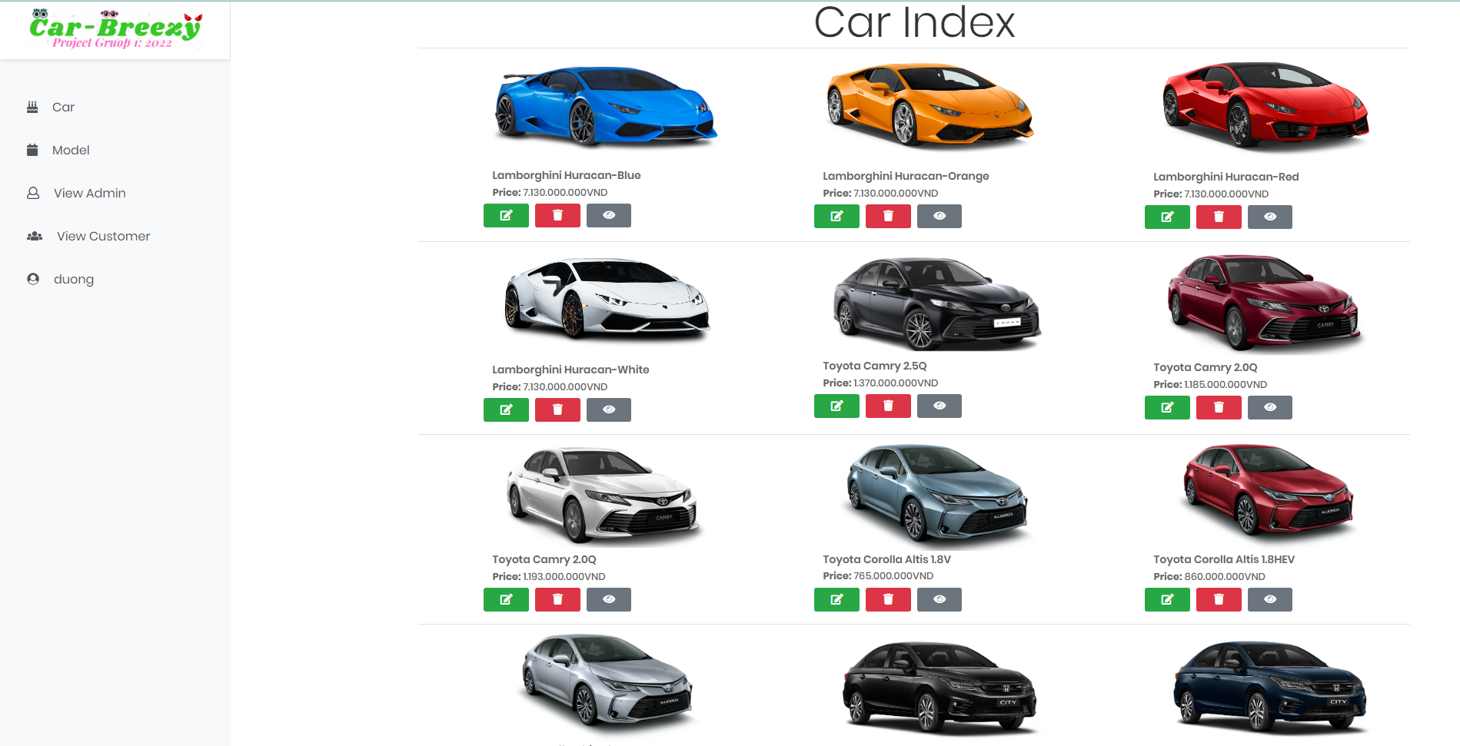
Cake View Page

Slide 27
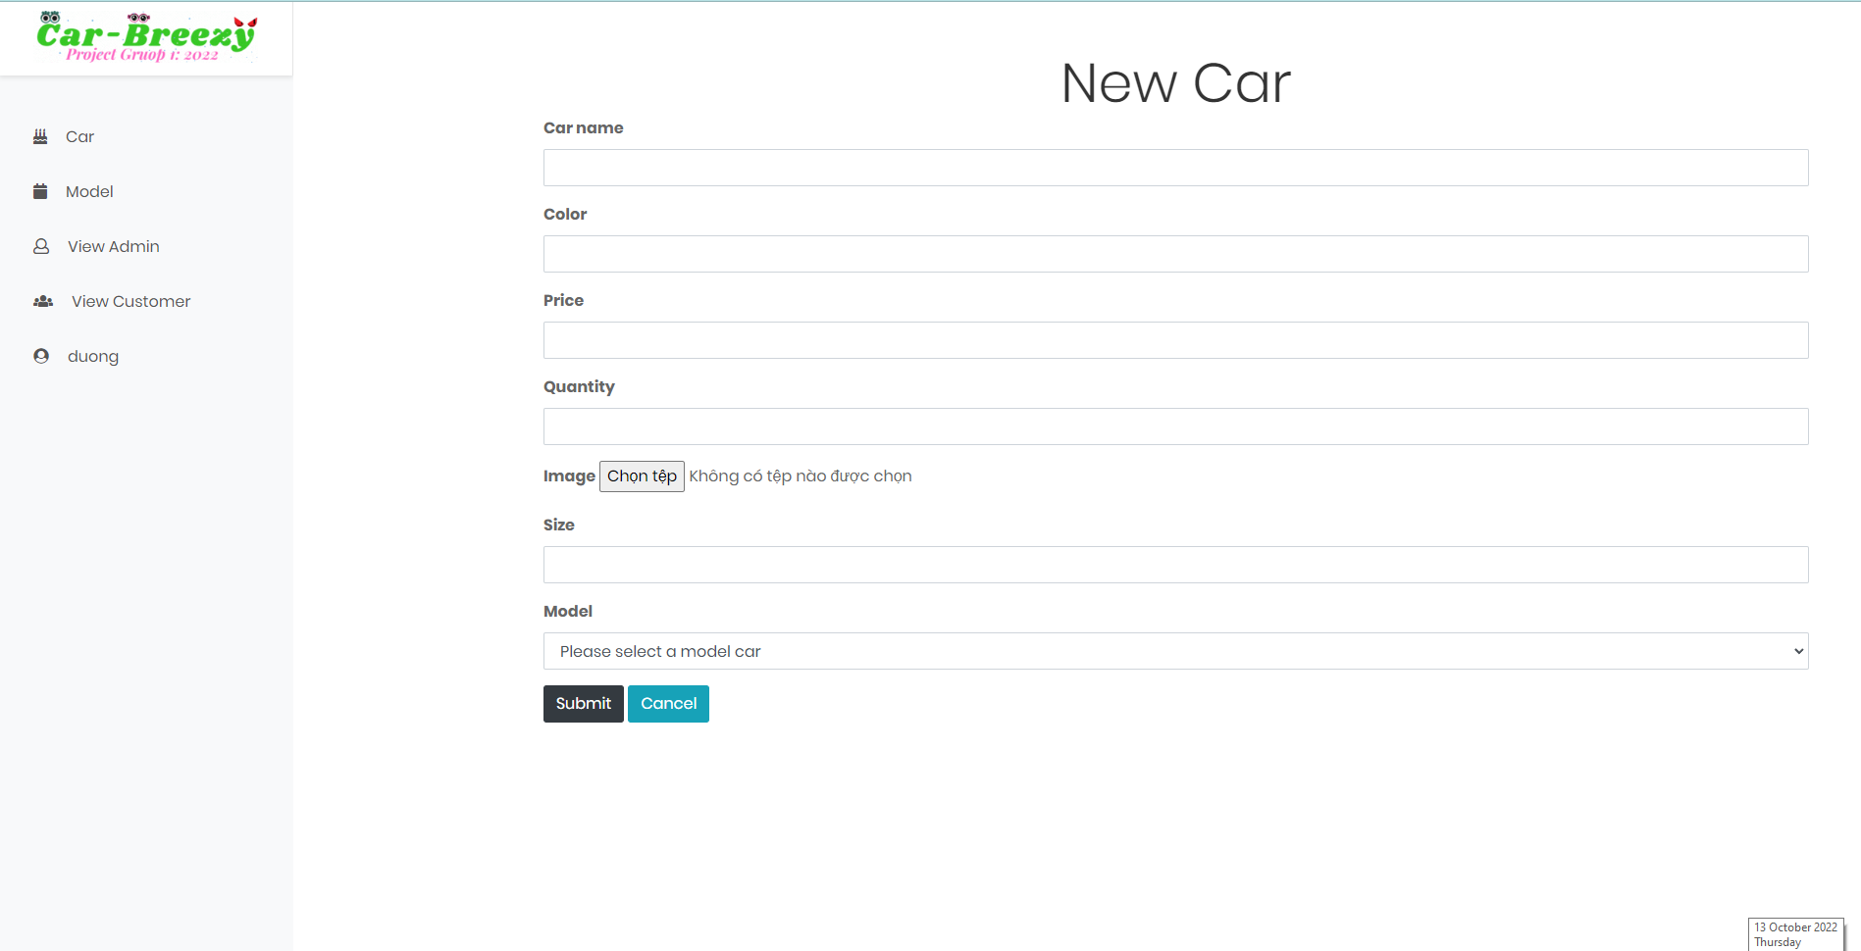
Cake View Page

Slide 28
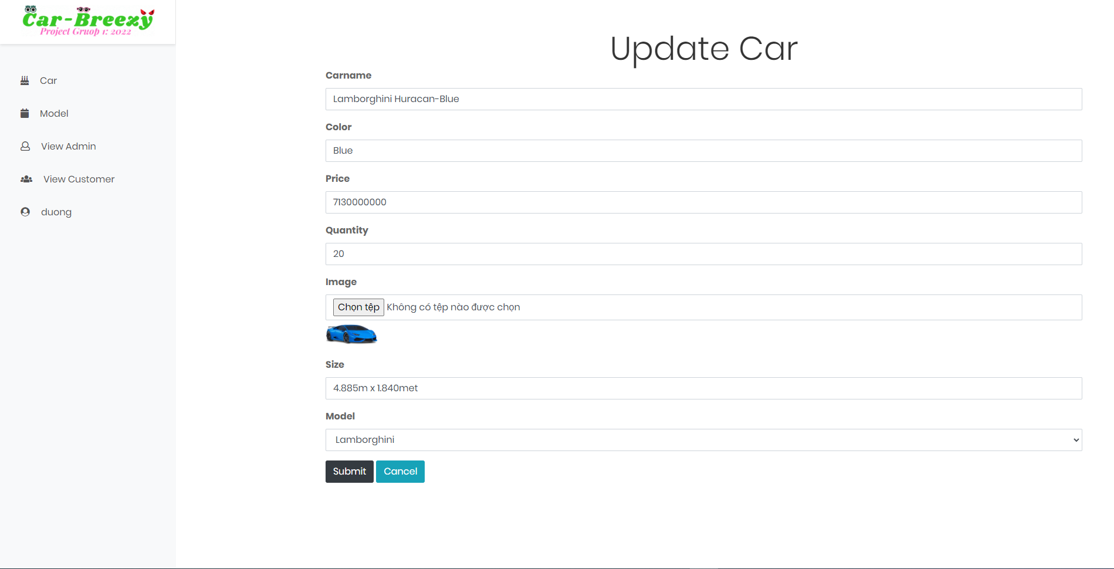

Slide 29
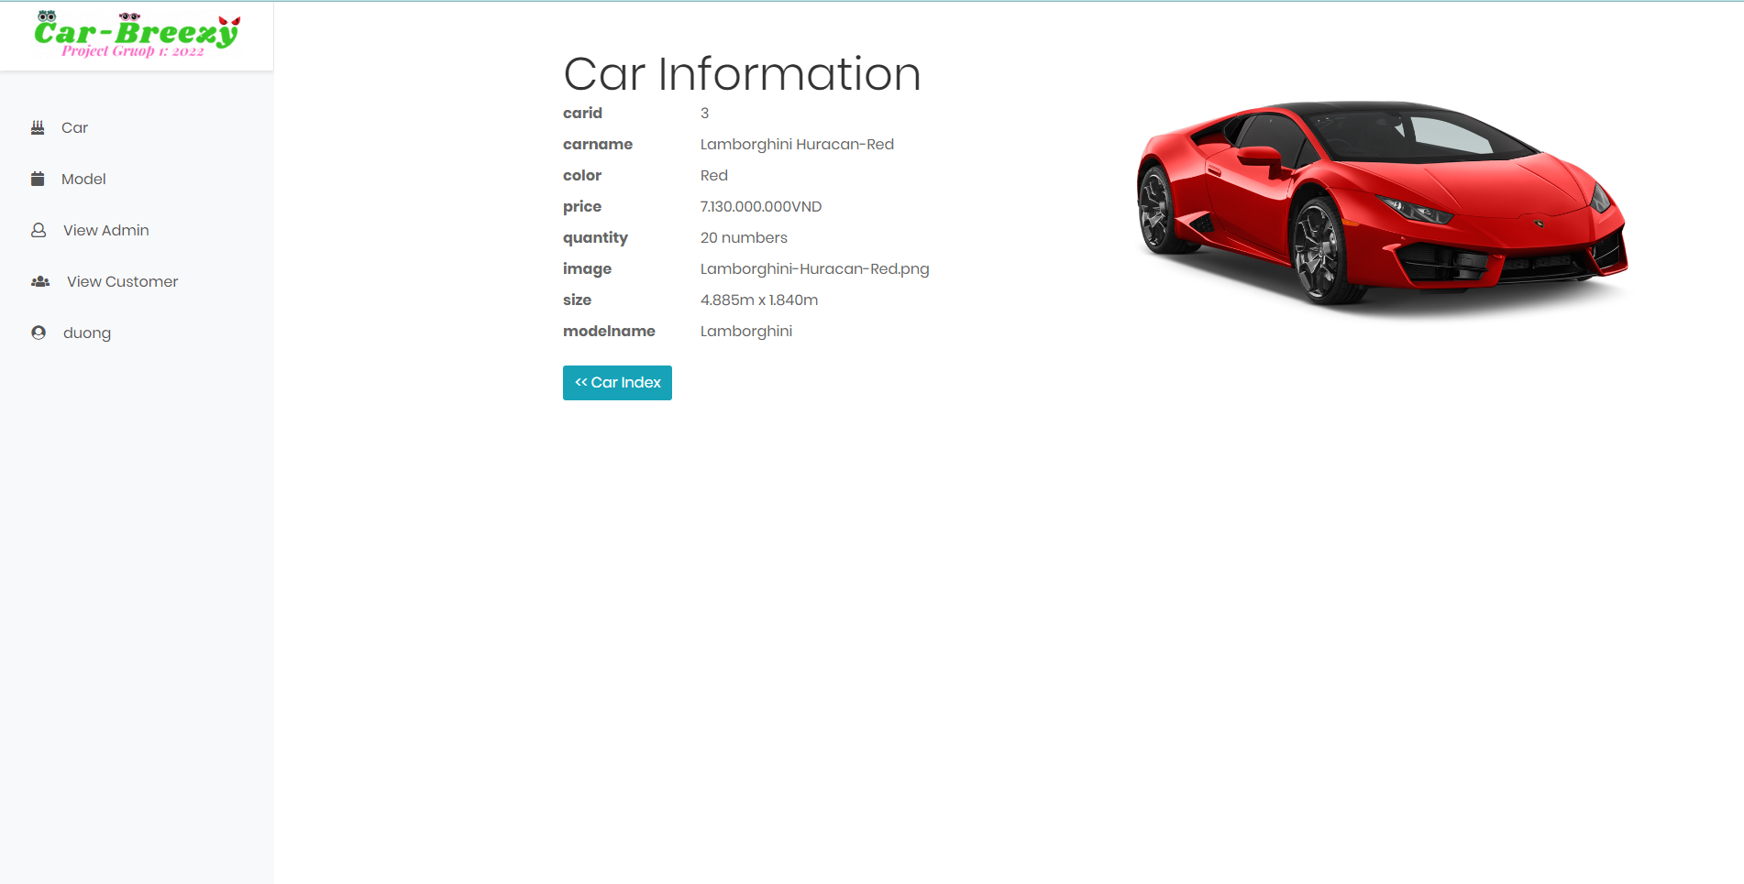

Slide 30
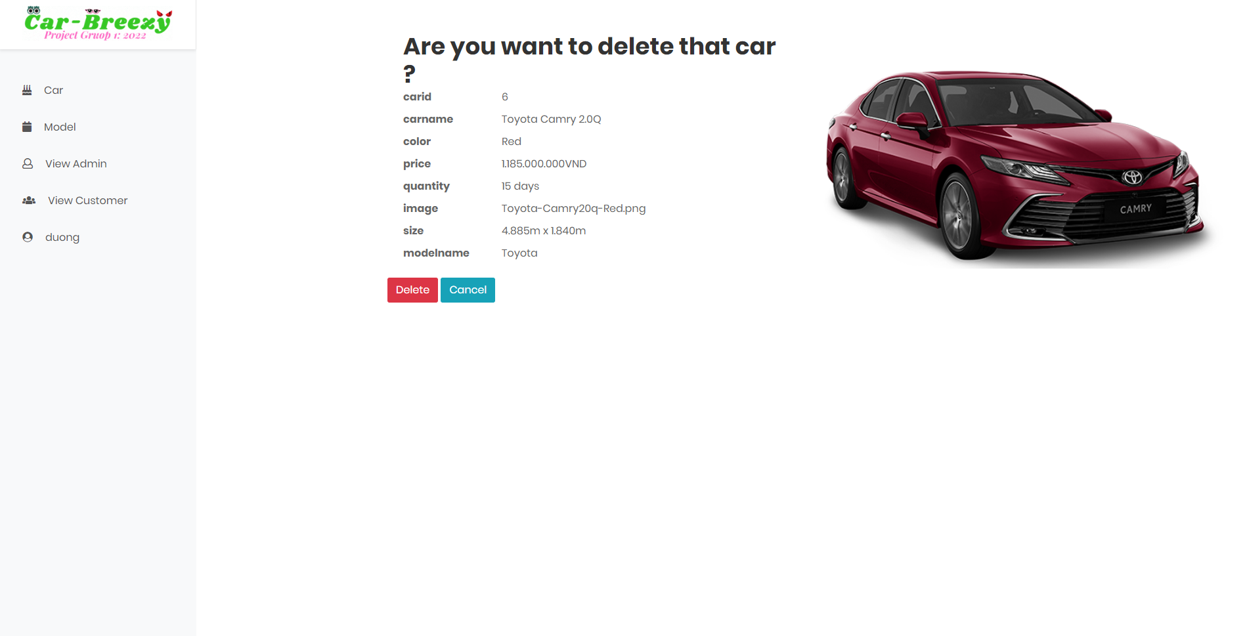

Slide 31
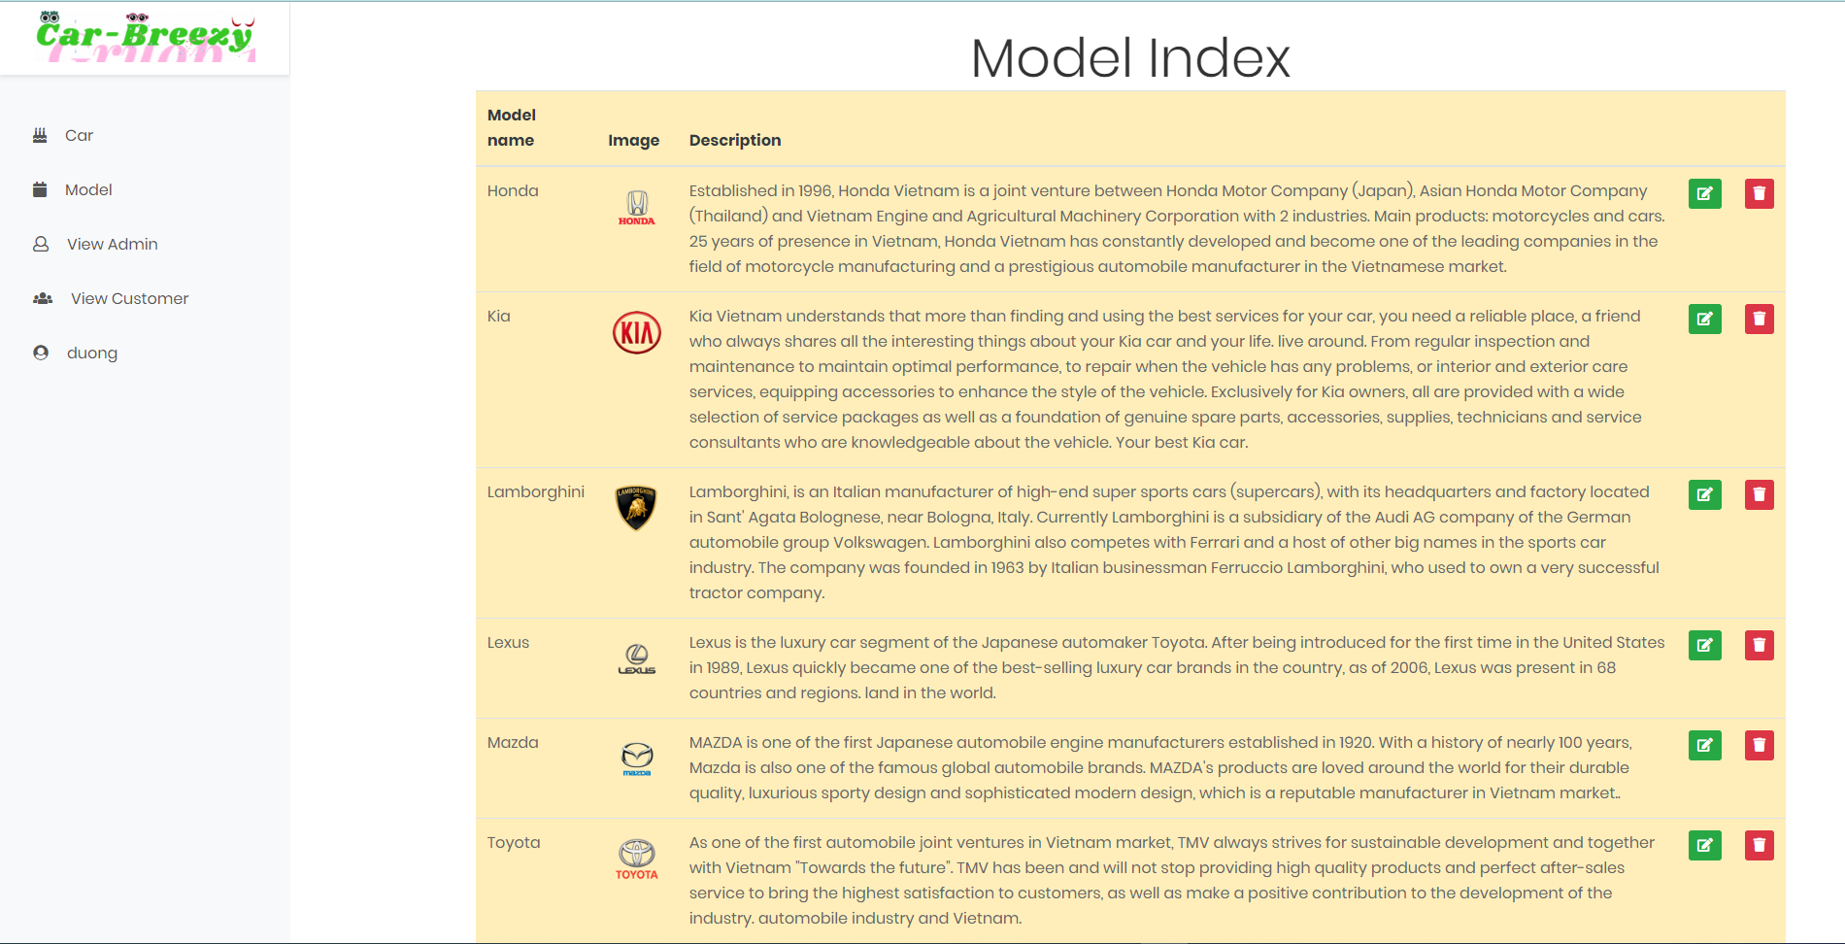

Slide 32
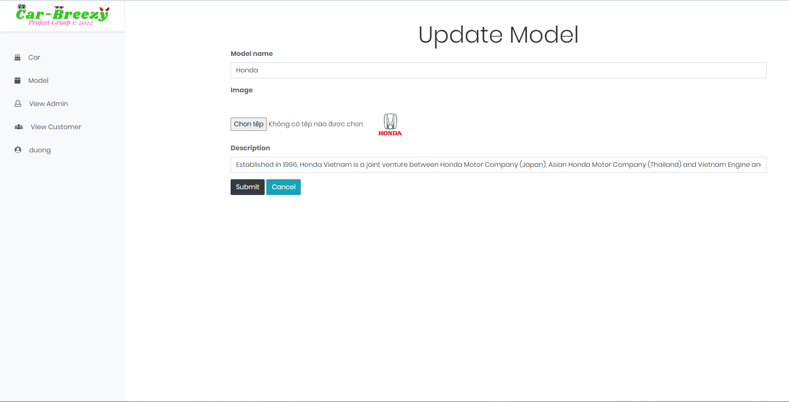

Slide 33
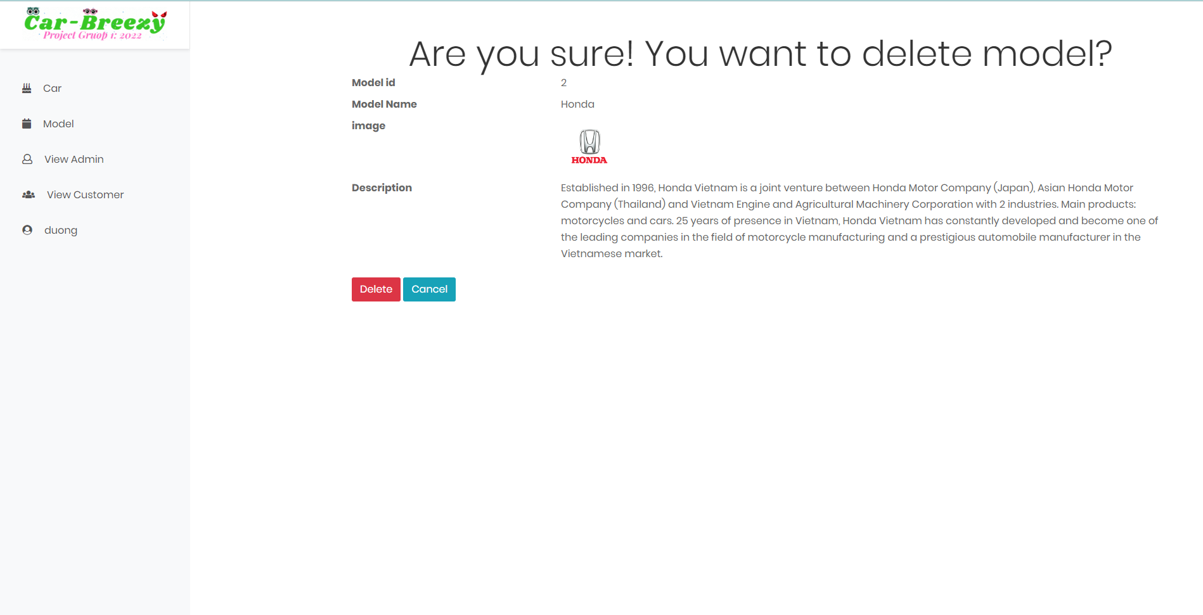

Slide 34
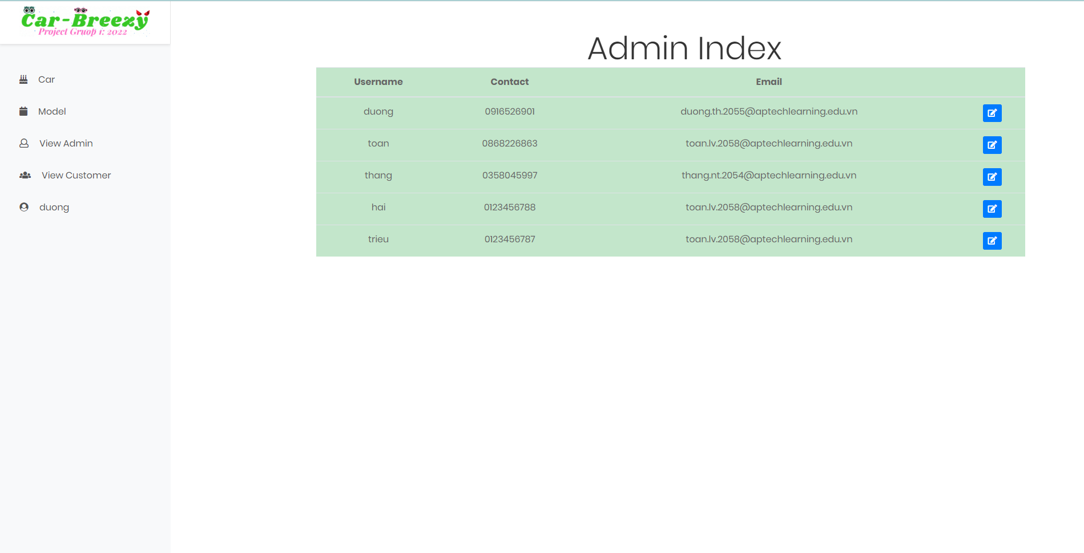

Slide 35
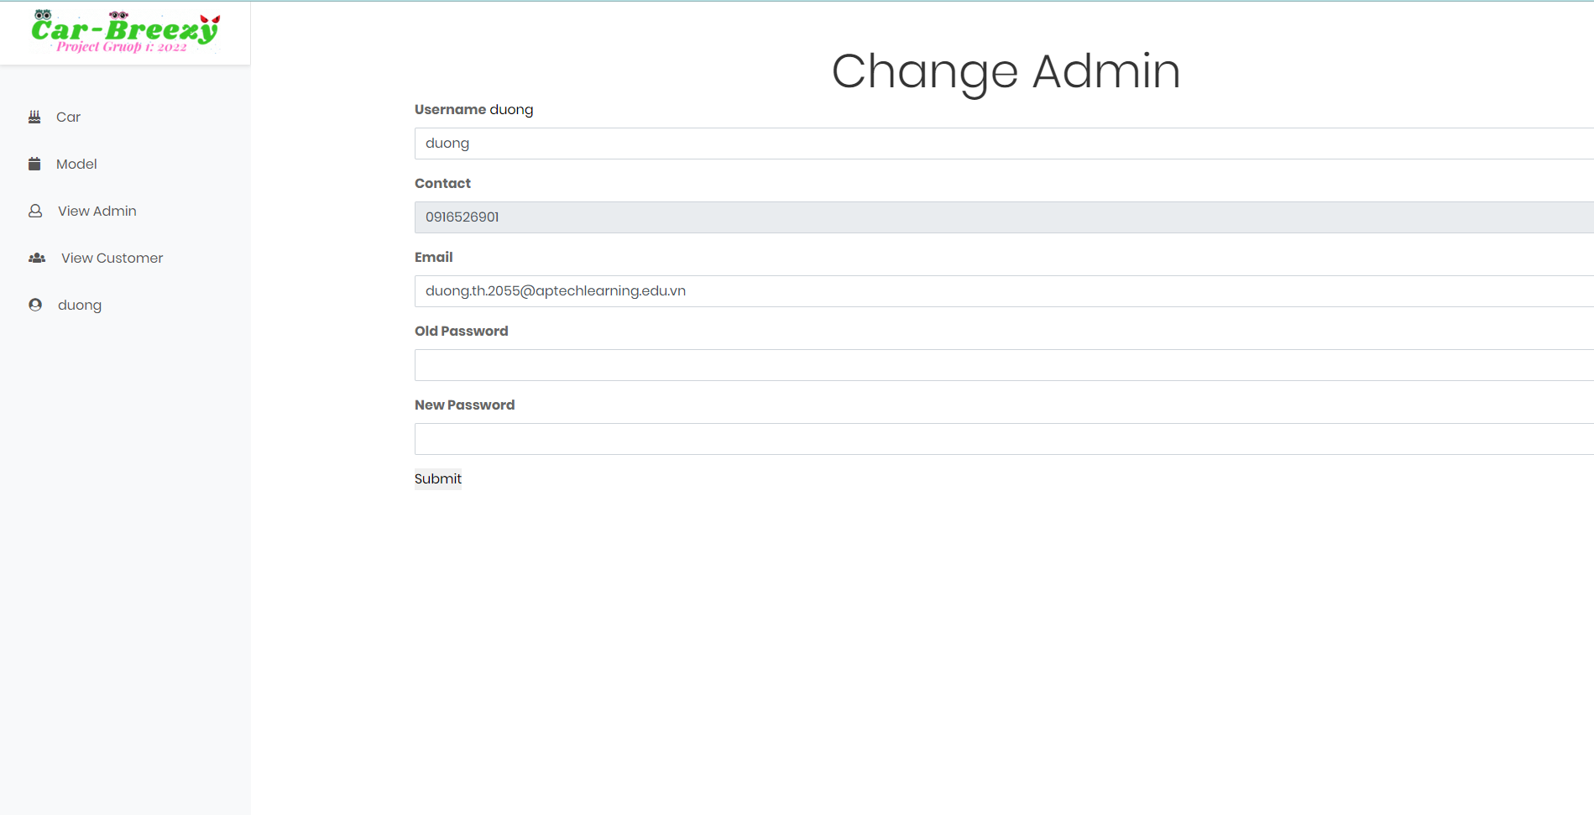

Slide 36
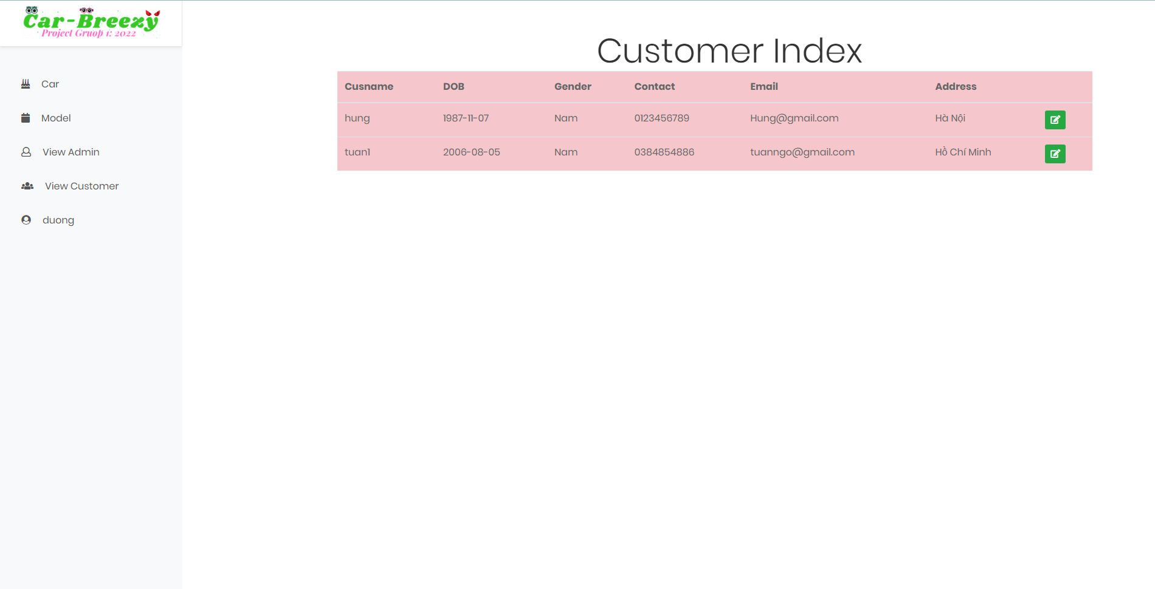

Slide 37
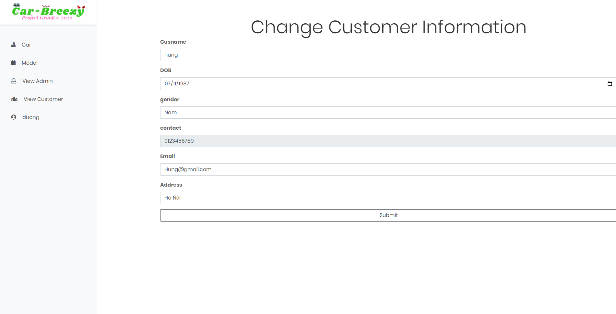

Slide 38

Navbar
Client Footer
Footer

Slide 39
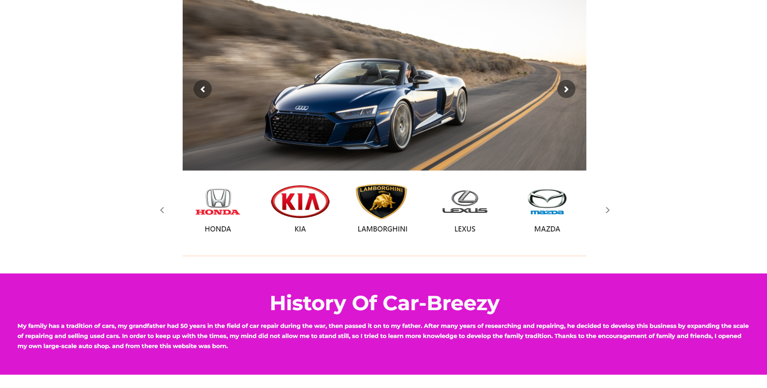

Slide 40
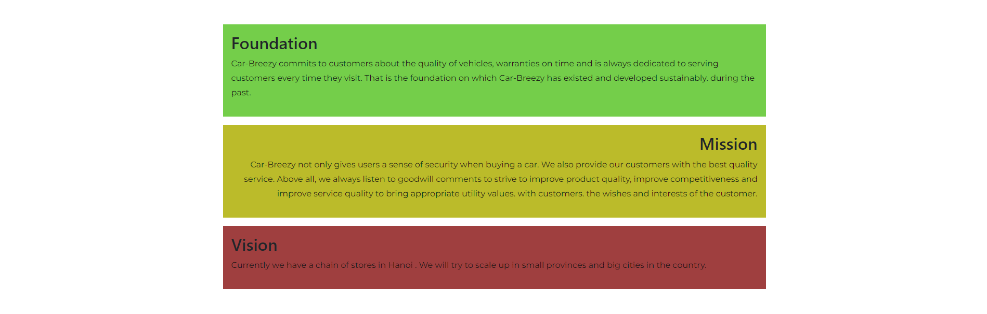

Slide 41

Model

Slide 42
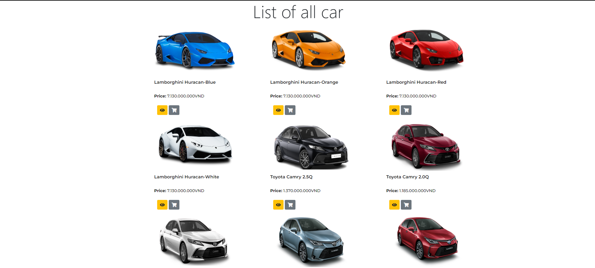

Slide 43
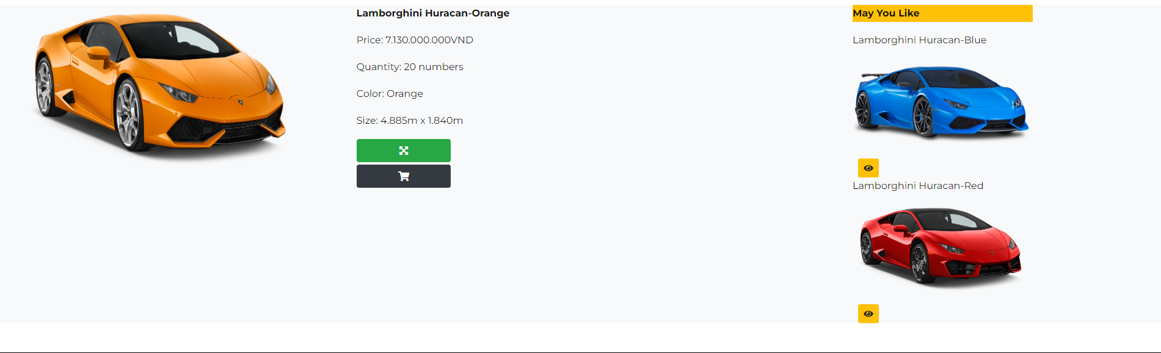

Slide 44
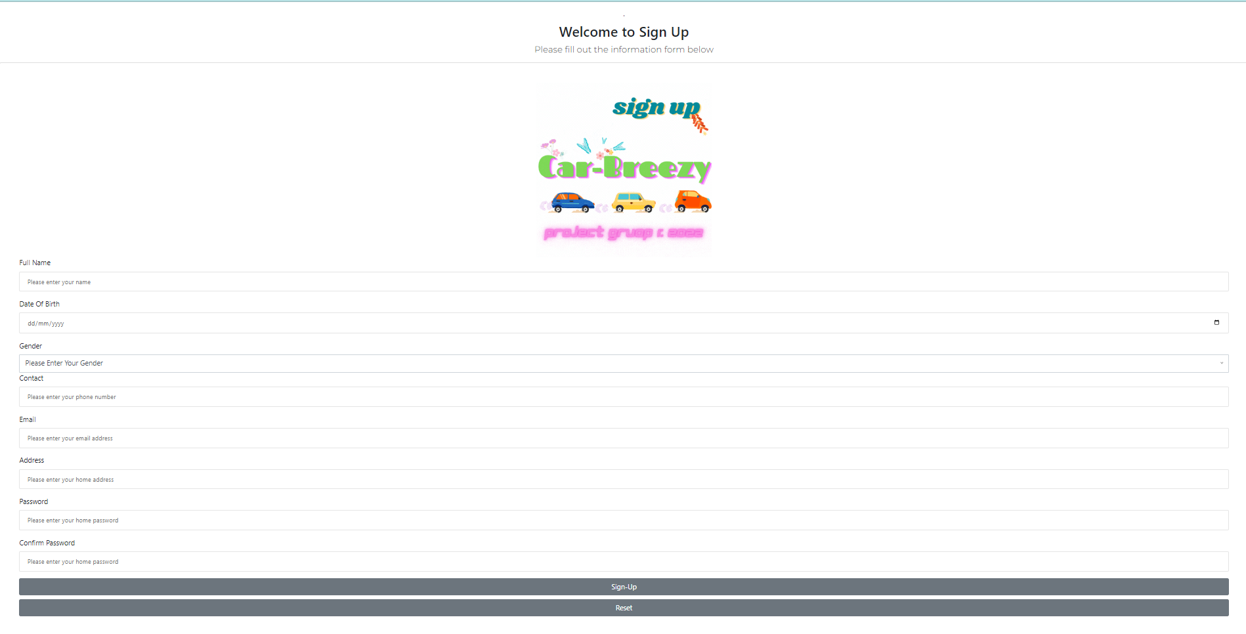

Slide 45
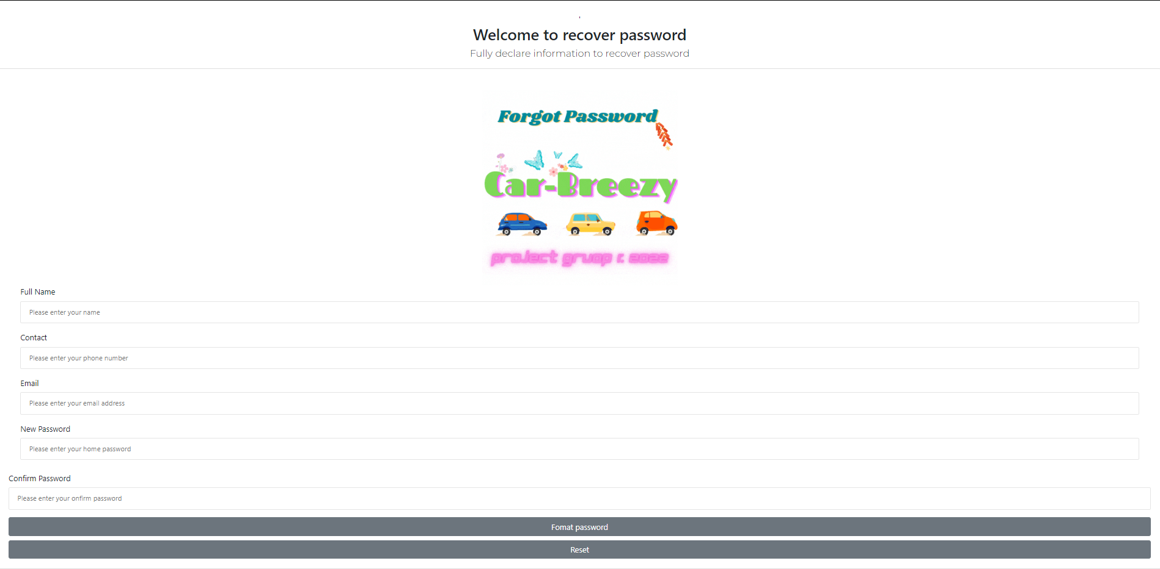

Slide 46
Login Customer

Slide 47
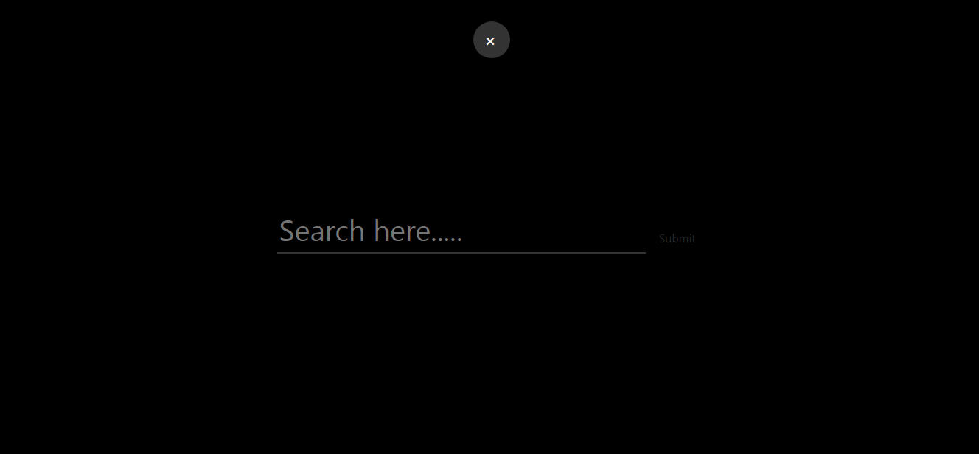

Slide 48
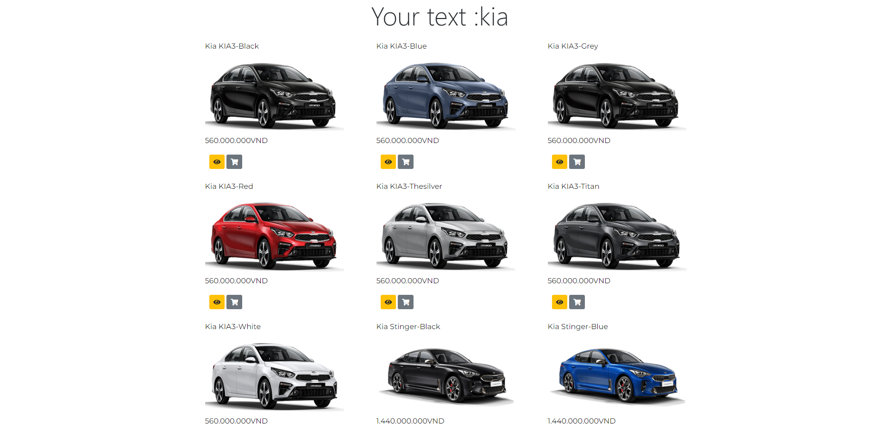

Slide 49
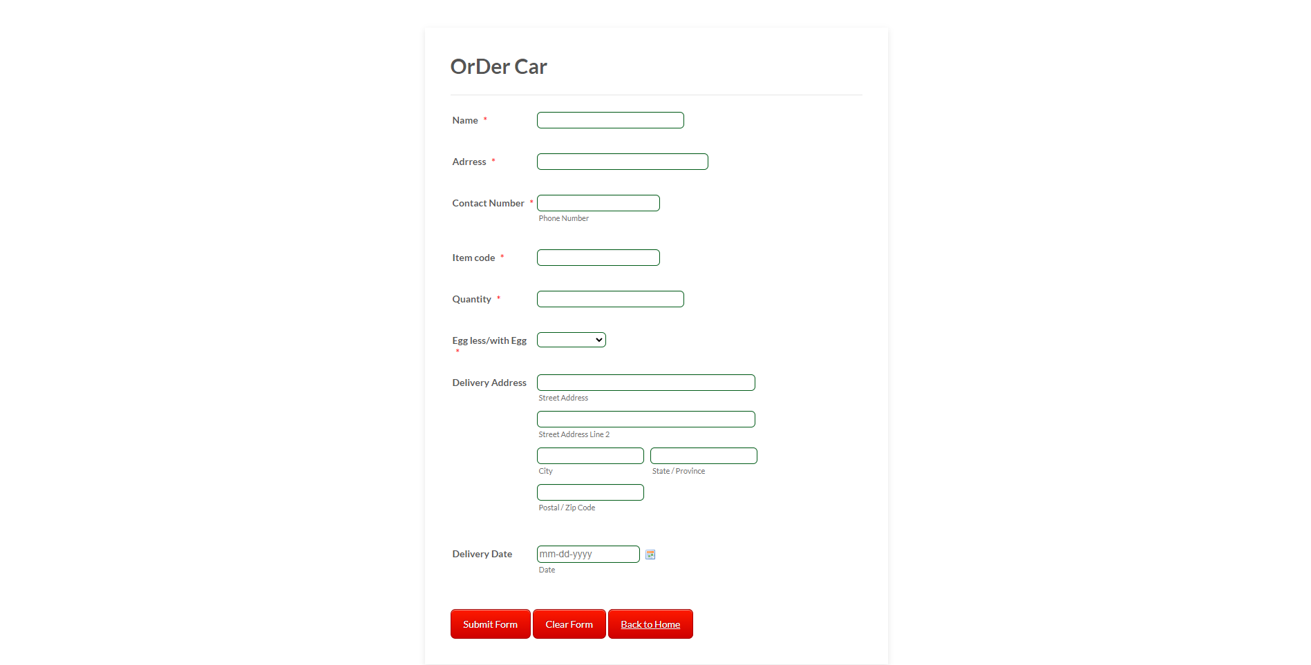

Slide 50
Thank’s You

